Slide 1
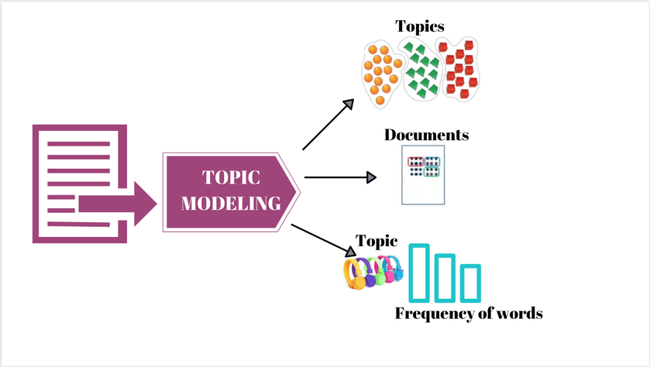
Latent Semantic Indexing
Name: Zubair Idrees
Student Id: 197301
Course: Data Mining

Slide 2
Latent Semantic Indexing (LSI)
LSI stands for Latent Semantic Index(ing).
It is designed to learn a wide variety of synonyms, based on context
Mathematical techniques are used to find relationships between words and concepts within a piece of content.
Latent → Hidden
Semantic → Relationships Between Words
Indexing → Information Retrieval

Slide 3
Latent Semantic Indexing (LSI)
Main Idea
Map each document into some ‘concepts’
Map each term into some ‘concepts’
‘Concepts’: ~ a set of terms, with weights.
For example, DBMS_concept:
“data” (0.8),
“system” (0.5)
“retrieval” (0.6)

Slide 4
Latent Semantic Indexing (LSI)
Term-Concept Matrix | Document-Concept Matrix
- | Database concept | Medical concept
Data | 1
System | 1
Retrieval | 1
Lung |  | 1
Ear |  | 1
 | Database concept | Medical concept
Doc1 | 1
Doc2 | 1
Doc3 |  | 1
Doc4 |  | 1

Slide 5
Latent Semantic Indexing (LSI) Q: How to search e.g., for “System”? A: Find the corresponding concept(s); and the corresponding documents
Term-Concept Matrix | Document-Concept Matrix
- | Database concept | Medical concept
Data | 1
System | 1
Retrieval | 1
Lung |  | 1
Ear |  | 1
 | Database concept | Medical concept
Doc1 | 1
Doc2 | 1
Doc3 |  | 1
Doc4 |  | 1
We may retrieve documents that DON’T have the term “system”, but they contain almost everything else (“data”, “retrieval”)

Slide 6
Applications
It is mainly used by search engines to study and compare relationships between different terms and concepts.
These keywords are also used by different websites to improve SEO traffic and create more visibility and higher rankings in search results.

Slide 7
How It’s Work
Build Vocabulary
Tokenization
Remove Stopwords
Stemming/Lemmatization
List down distinct words
Term Document Matrix
Apply SVD on Term-Document Matrix
Create k Rank Approximation Matrix

Slide 8
1.Build Vocabulary a) Tokenization
Tokenization is essentially splitting a phrase, sentence, paragraph, or an entire text document into smaller units, such as individual words or terms. Each of these smaller units are called tokens.
Let’s take an example. Consider the below string:
“This is a cat.”
What do you think will happen after we perform tokenization on this string? We get [‘This’, ‘is’, ‘a’, cat’].

Slide 9
1.Build Vocabulary b) Eliminate Stopwords
Stopwords are the most common words in any natural language. For the purpose of analyzing text data and building NLP models, these stopwords might not add much value to the meaning of the document. Generally, the most common words used in a text are “the”, “is”, “in”, “for”, “where”, “when”, “to”, “at” etc

Slide 10
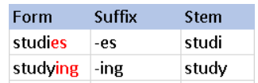
1.Build Vocabulary c) Stemming
Stemming is a technique used to extract the base form of the words by removing affixes from them. It is just like cutting down the branches of a tree to its stems.
Search engines use stemming for indexing the words. That’s why rather than storing all forms of a word, a search engine can store only the stems. In this way, stemming reduces the size of the index and increases retrieval accuracy.
Example

Slide 11
1.Build Vocabulary c) Lemmatization
Lemmatization technique is like stemming. The output we will get after lemmatization is called ‘lemma’, which is a root word rather than root stem, the output of stemming. After lemmatization, we will be getting a valid word that means the same thing.
Example
Word | lemma
studies | study
study | study

Slide 12
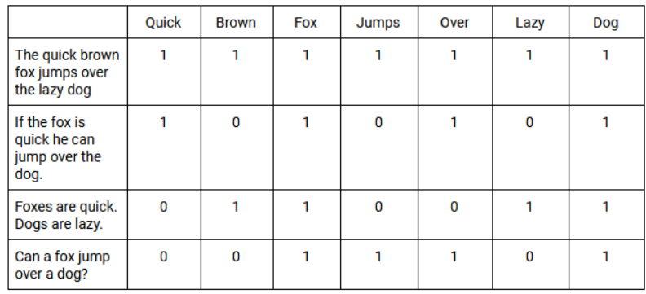
2.Term Document Matrix
A TDM is a 2D grid that lists the frequency that each specific word (or term) occurs in the documents within a data set.
Weighing functions are then applied to the TDM. A simple example is classifying all documents that contain the word with a value of 1 and all that don’t with a value of 0.

Slide 13
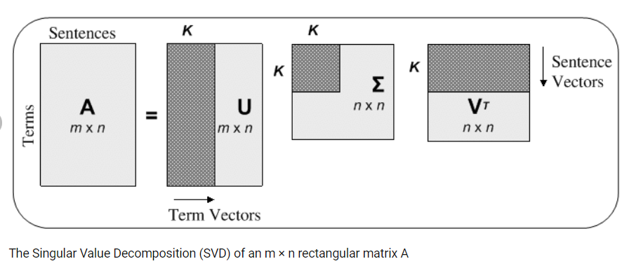
3.Singular Value Decomposition (SVD)
Singular value decomposition is a method of decomposing a matrix into three other matrices

Slide 14
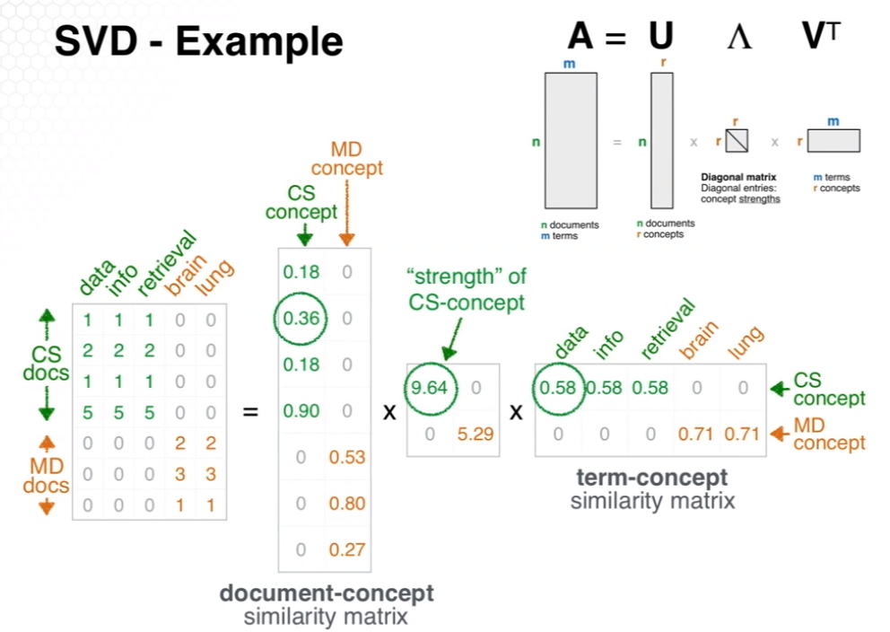
3.Singular Value Decomposition (SVD)

Slide 15
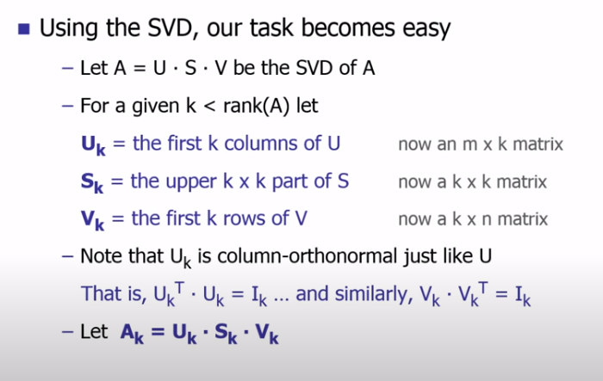

4. k Rank Approximation Matrix

Slide 16
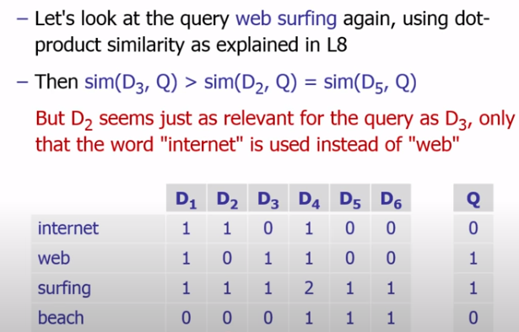
Example

Slide 17
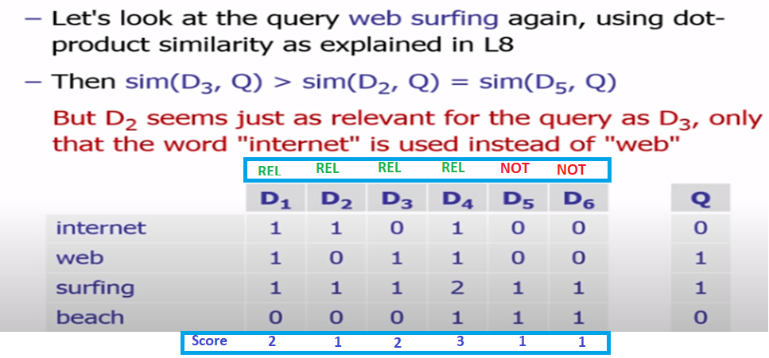
Example

Slide 18





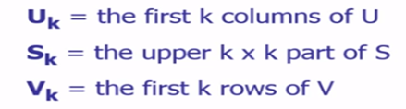
Example
Matrix A | =>
SVD(A) | => | U | S | V
Rank of (A) = 3 Rank 2 (A) | =>

Slide 19
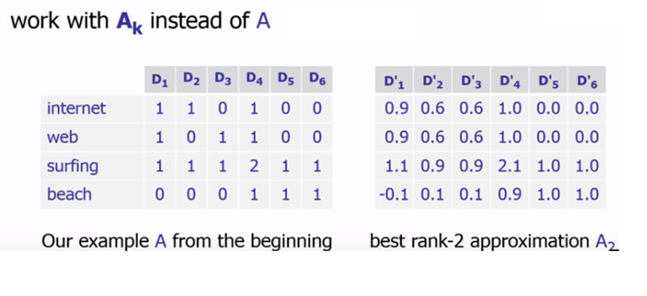
Example

Slide 20
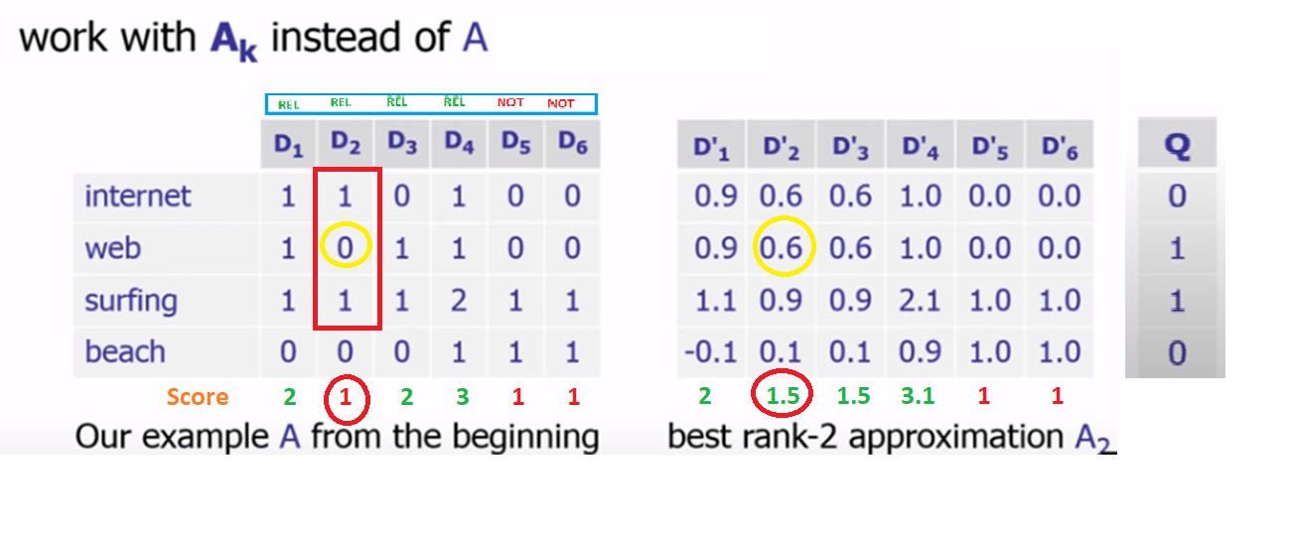
Example

Slide 21
How to Select ‘k’ value
A high k value may seem advantageous because one compares all documents across more concepts, but can be detrimental due to added noise.
A low k value suffers from the danger of discarding crucial, distinguishing concepts in the data.
This problem can be ameliorated to a certain extent by optimizing the precision and recall of LSI retrieval

Slide 22
Advantages & Disadvantages
Advantages
Easy to implement, understand and use.
Capable of assuring decent results , much better than plain vector space model. It works well on dataset with diverse topics.
Handle synonymy problems to some extent (depends on dataset though)
Apply it on new data is easier and faster compared to other methods.
Disadvantages
Difficult to select the ‘k’ value
It is computationally intensive. Calculating the SVD of a matrix M via reduction to a bidiagonal matrix has a computational complexity of O [m × n × min (m, n)].
The ordering of words in a document is completely disregarded.

Slide 23
References
Latent Semantic Indexing | What Is It and 3 Ways on How to Use It - YouTube
Information Retrieval WS 17/18, Lecture 10: Latent Semantic Indexing - YouTube
CSE6242 wk14 16 1 2 latent semantic indexing - YouTube
https://www.ncbi.nlm.nih.gov/pmc/articles/PMC3558626/#:~:text=LSI%20possesses%20advantages%20over%20other,%2Dnecessarily%20square)%20input%20matrix.

Slide 24
Question?

